Slide 1
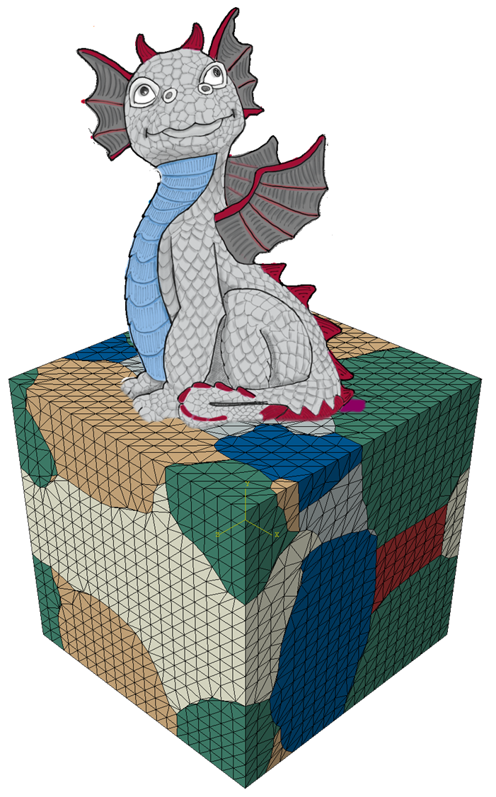
DRAGen – Discrete RVE Automation and Generation
DRAGen – Beta Release Event
M. Henrich M.Sc., Niklas Fehlemann M.Sc., Orkun Karagüllü M.Sc., Maximilian Neite M.Sc.

Slide 2
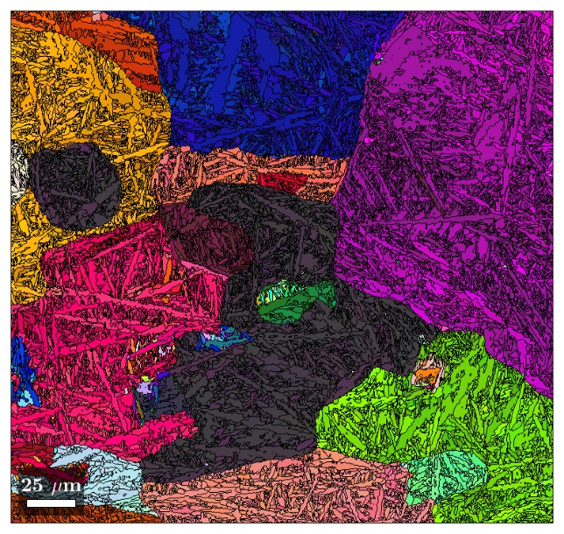
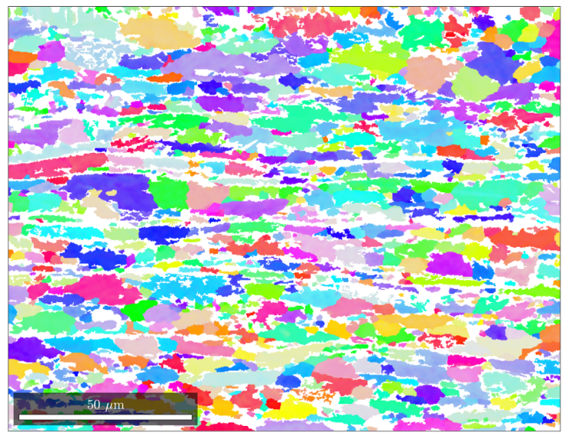

Introduction – Why DRAGen?
RVEs “should contain enough information on the microstructure yet be sufficiently smaller than the macroscopic structural dimensions. Thus, a separation of scales should be enabled” [1].
Dream3D supports:
Grain-shape and -size reconstruction
Texture reconstruction
Voxelmesh is standard, laplace smoothing available
Neper supports:
Grain size reconstruction with voronoi
Grain shape reconstruction with Aspectratio distribtion (experimental state)
Texture reconstruction including substructures
DRAGen supports:
Coupled Grain size and shape reconstruction based on Neural Networks
Texture reconstruction including substructure
Band reconstruction of secondary phase
Inclusion reconstruction
Laplace smoothed Hex-mesh is standard, (Voxelmesh available)
Surface Roughness
[1] Gitman, I.M.; Askes, H.; Sluys, L.J. Representative volume: Existence and size determination. Eng. Fract. Mech. 2007, 74, 2518–2534.

Slide 3
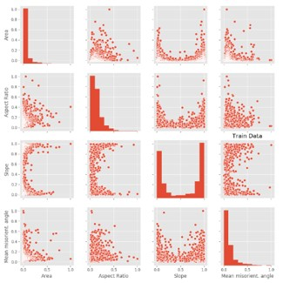
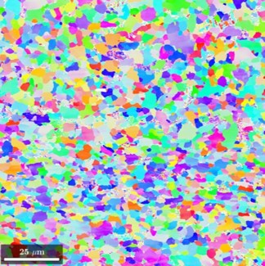
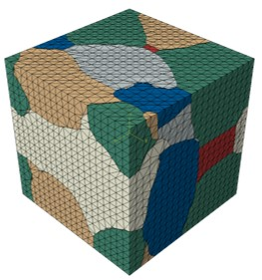
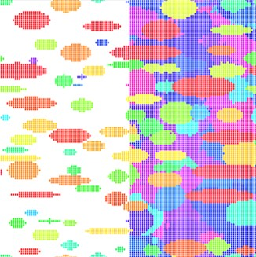
DRAGen – The Main Idea
Microstructure analysis
LOM
SEM
Statistical analysis
Grain size
Aspect ratio
Slope
Grain packing & volume filling
Packing-Algorithm e.g. RSA
Tessellation e.g. Voronoi
Building the FE model
Generating geometries
Meshing geometries

Slide 4
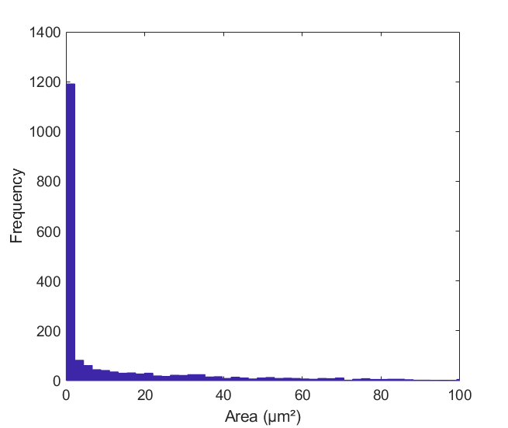
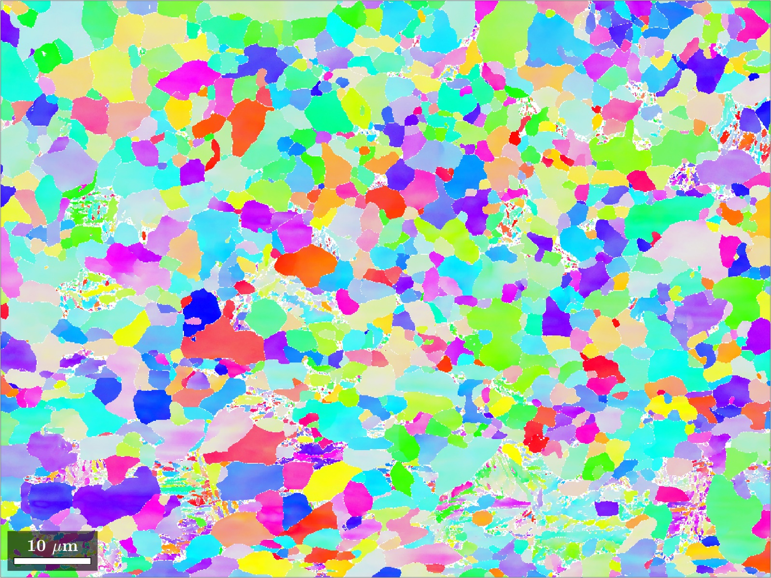
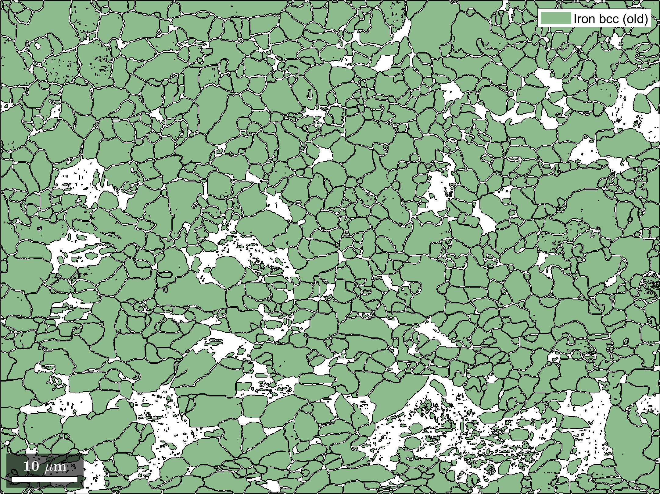
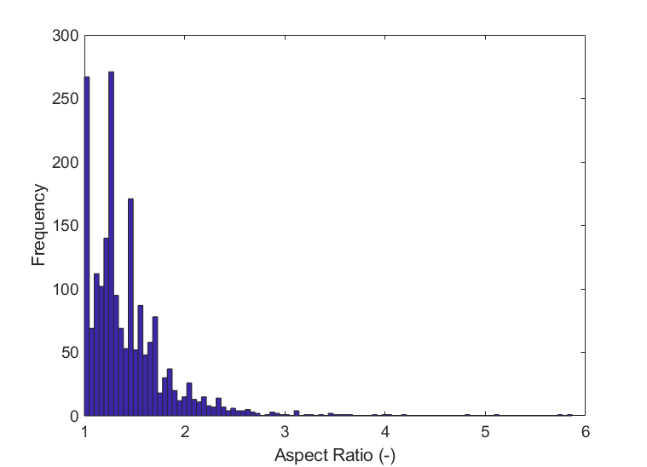
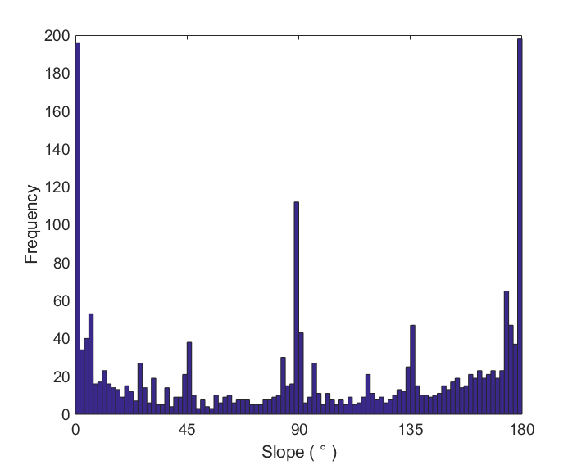
Microstructure Measurement
Ferrit 79%
Martensit 21%

Slide 5
DRAGen – The Main Idea
Microstructure analysis
LOM
SEM
Statistical analysis
Grain size
Aspect ratio
Slope
Grain packing & volume filling
Packing-Algorithm e.g. RSA
Tessellation e.g. Voronoi
Building the FE model
Generating geometries
Meshing geometries

Slide 6
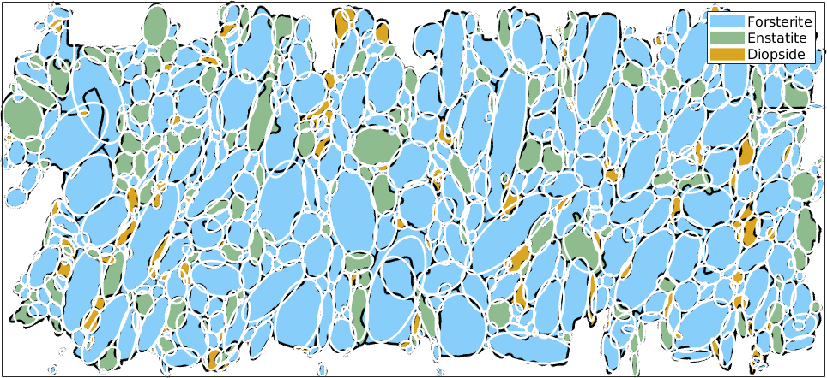
Input Data – Using a csv-File
from analysis of EBSD pictures via MATLAB toolbox MTEX,
command grains.fitEllipse
.csv files as input:
a in rolling direction, aligned with x-axis; b with y-axis and c with z-axis
[1]
Header: | a | b | c | alpha | phi1 | PHI | phi2
Description: | grain radius | grain radius | grain radius | grain slope x-y-plane | euler angle | euler angle | euler angle
Required: | mandatory | optional | optional | optional | optional | optional | optional
Default: |  | a | a | 0 | random | random | random
[1]: MTEX Documentation. https://mtex-toolbox.github.io/EllipseBasedParameters.html (last accessed: 10.05.2021)

Slide 7
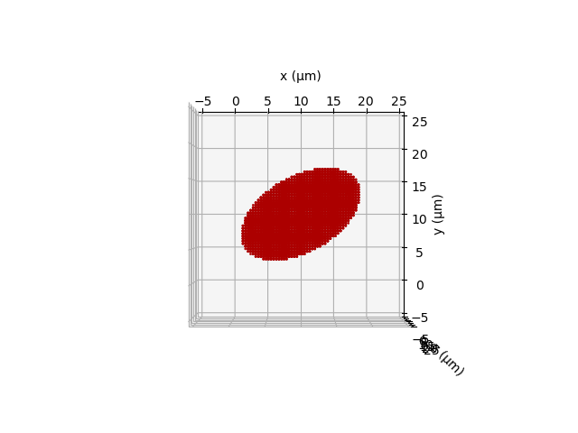
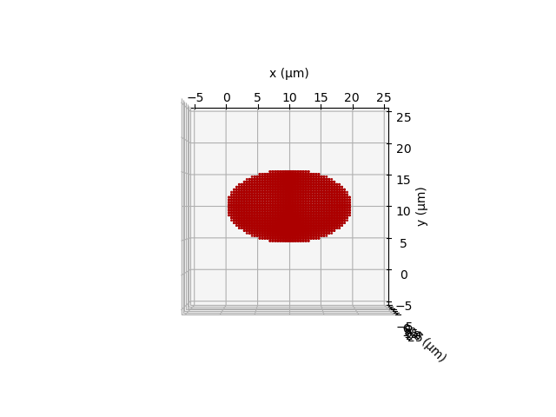
Input Data – Rotation & Texture
Slope
implemented via slope alpha for each grain
slope alpha relative to x-axis (radius a, RD)
counterclockwise rotation in x-y-plane
default: alpha = 0°
y*
x*
alpha
y
z
x
alpha = 30°
default: alpha = 0°
Texture
implemented via the three euler angles phi1, PHI, phi2 for each grain (default: random texture)
information stored in the output file for the crystal plasticity model grainsdata.inp

Slide 8
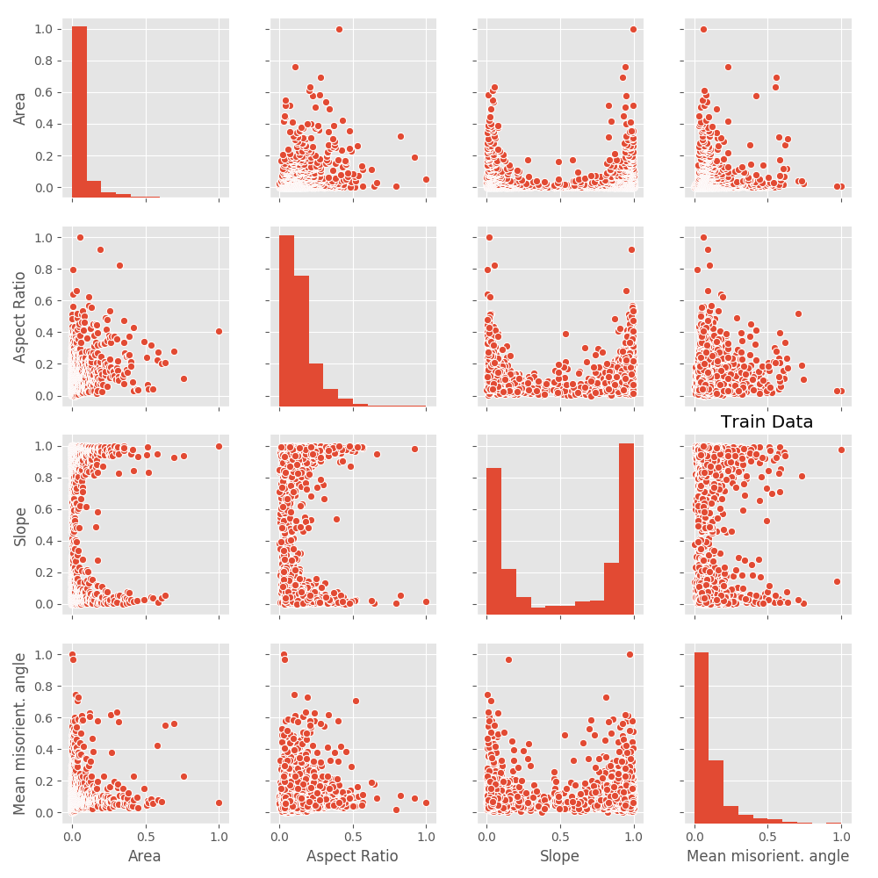
Input Data – Using Machine Learning
Trainingsdaten aus EBSD-Messungen

Slide 9
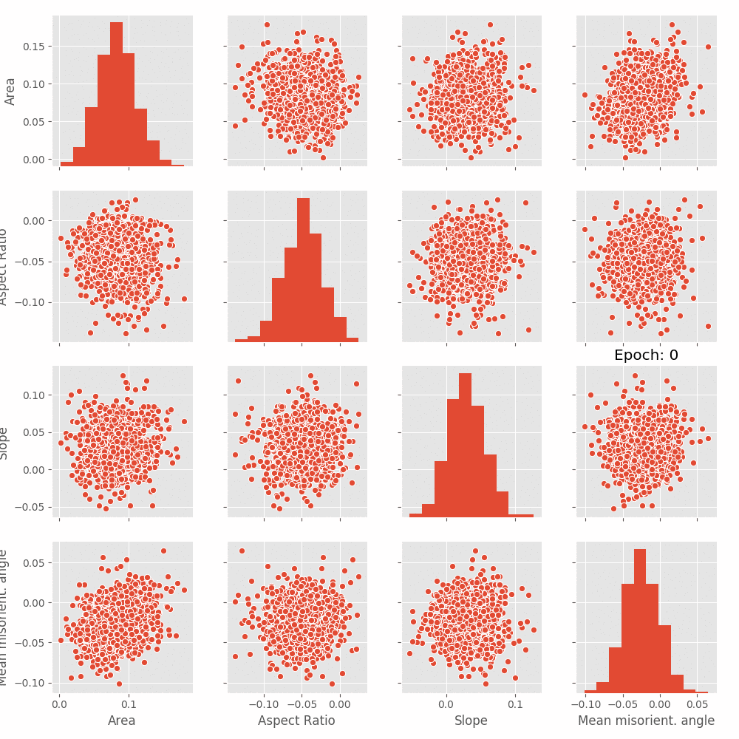
Input Data – Using Machine Learning
Wasserstein-Loss
Real Daten
Diskriminator
Labels
Generator
Synthetische Daten
z
Wasserstein-Loss
Currently only supported in development mode please approach Niklas for further information

Slide 10
DRAGen – The Main Idea
Microstructure analysis
LOM
SEM
Statistical analysis
Grain size
Aspect ratio
Slope
Grain packing & volume filling
Packing-Algorithm e.g. RSA
Tessellation e.g. Voronoi
Building the FE model
Generating geometries
Meshing geometries

Slide 11
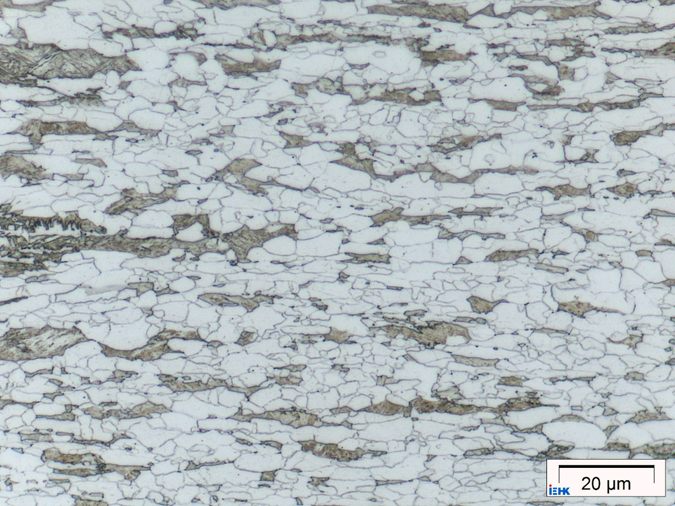
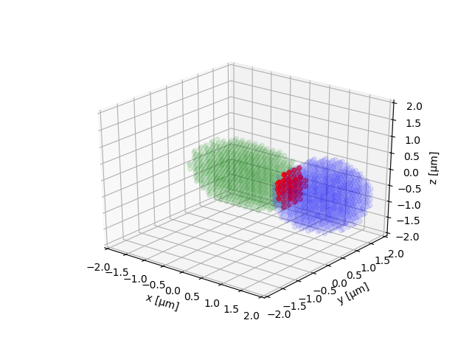
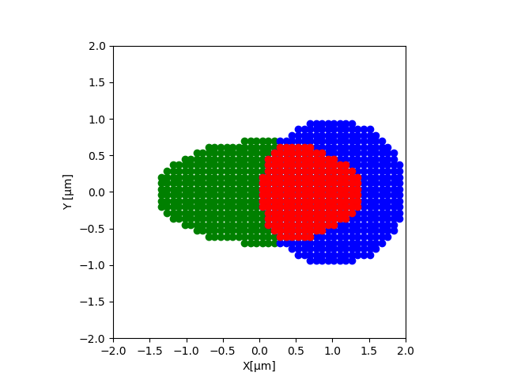
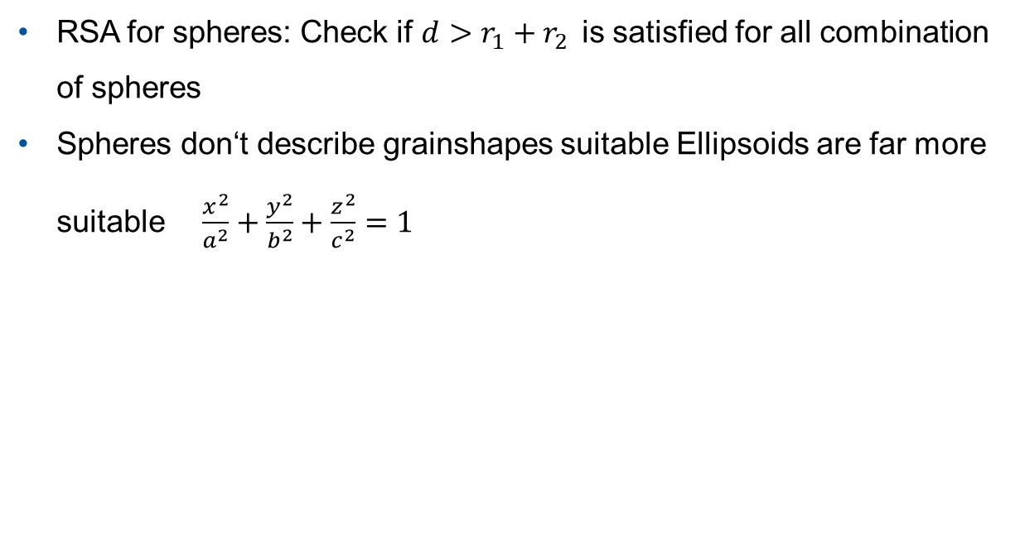
The Generation Process – Why Ellipsoids?
RSA for spheres: Check if $d>r_{1}+r_{2}$is satisfied for all combination of spheres
Spheres don‘t describe grainshapes suitable Ellipsoids are far more suitable $\frac{x^{2}}{a^{2}}+\frac{y^{2}}{b^{2}}+\frac{z^{2}}{c^{2}}=1$

Slide 12
The Generation Process – Generating the Grid
Phase 1 – Read input:
Input data is read
Total volume is discretized and converted to numpy array
Ellipsoids from input are discretized and converted to numpy array
Phase 2 – RSA-Algorithm:
Numpy array is randomly filled with ellipsoids starting with biggest
Intersections are forbidden
Phase 3 – Tesselation-Algorithm:
Ellipsoids grow with weighted speed
If maximum volume of an ellipsoid is reached growth stops
Numpy array is kept periodic during the complete process

Slide 13
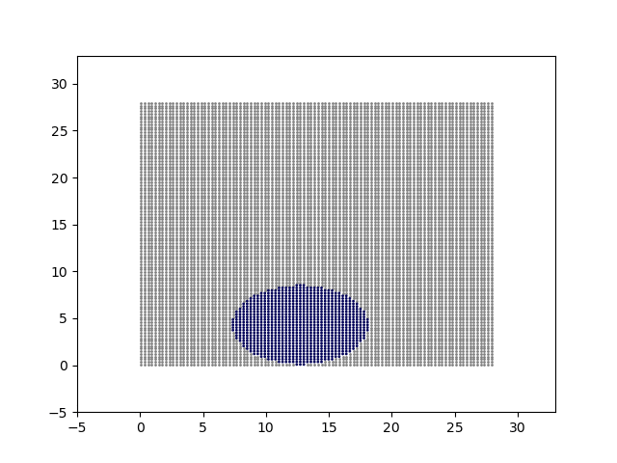
The Generation Process – Generating the Grid
Phase 1 – Read input:
Input data is read
Total volume is discretized and converted to numpy array
Ellipsoids from input are discretized and converted to numpy array
Phase 2 – RSA-Algorithm:
Numpy array is randomly filled with ellipsoids starting with biggest
Intersections are forbidden
Phase 3 – Tesselation-Algorithm:
Ellipsoids grow with weighted speed
If maximum volume of an ellipsoid is reached growth stops
Numpy array is kept periodic during the complete process

Slide 14
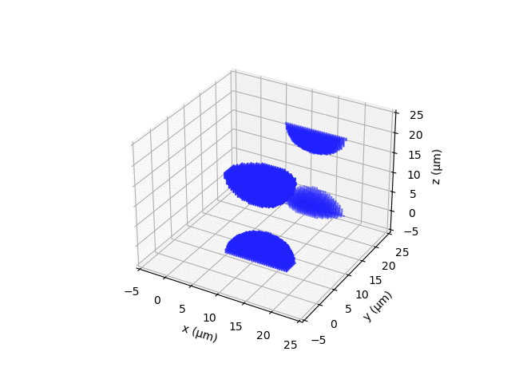
The Generation Process – Generating the Grid
Phase 1 – Read input:
Input data is read
Total volume is discretized and converted to numpy array
Ellipsoids from input are discretized and converted to numpy array
Phase 2 – RSA-Algorithm:
Numpy array is randomly filled with ellipsoids starting with biggest
Intersections are forbidden
Phase 3 – Tesselation-Algorithm:
Ellipsoids grow with weighted speed
If maximum volume of an ellipsoid is reached growth stops
Numpy array is kept periodic during the complete process

Slide 15
DRAGen – The Main Idea
Microstructure analysis
LOM
SEM
Statistical analysis
Grain size
Aspect ratio
Slope
Grain packing & volume filling
Packing-Algorithm e.g. RSA
Tessellation e.g. Voronoi
Building the FE model
Generating geometries
Meshing geometries

Slide 16
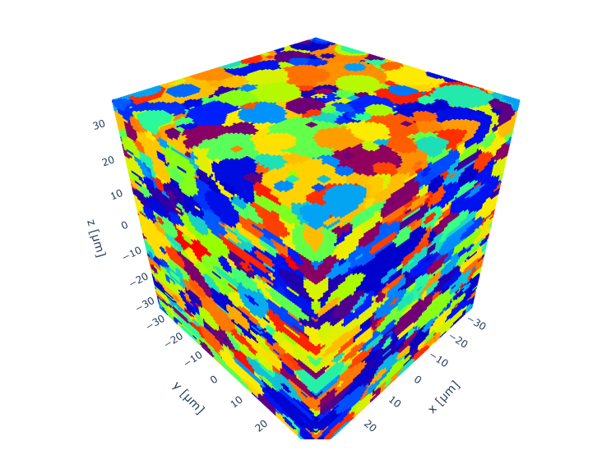
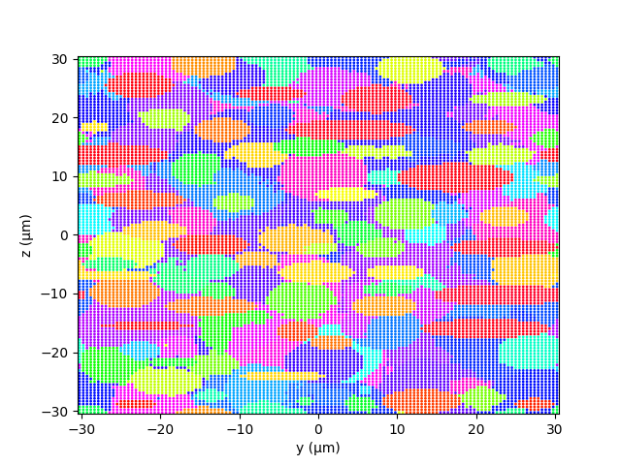
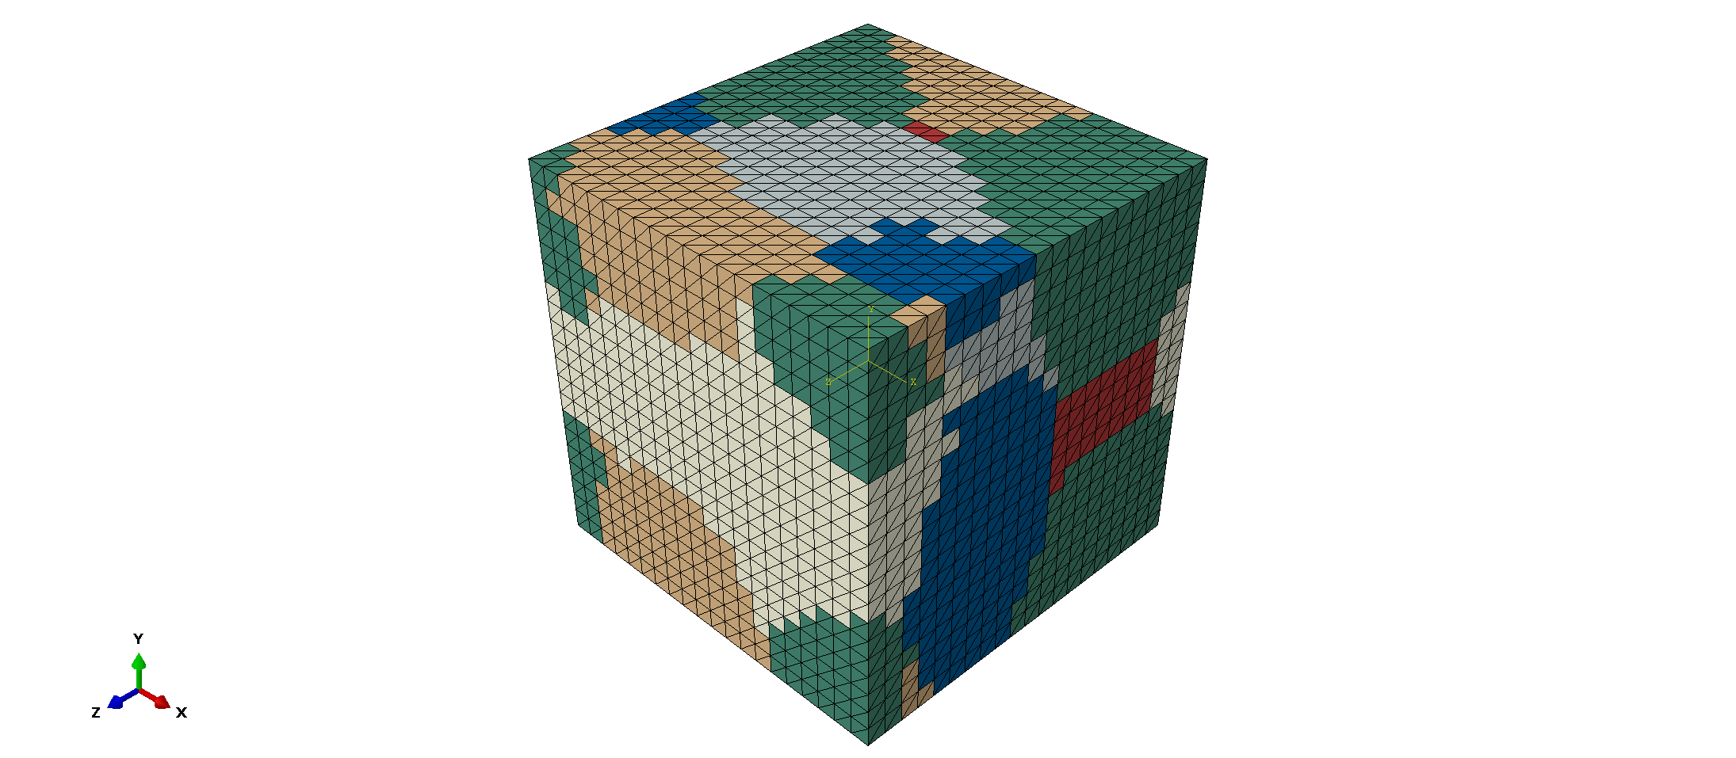

The Generation Process – Building the Model
Use a spectral solver
Convert points into an FE-mesh with smoothing algorithm

Slide 17
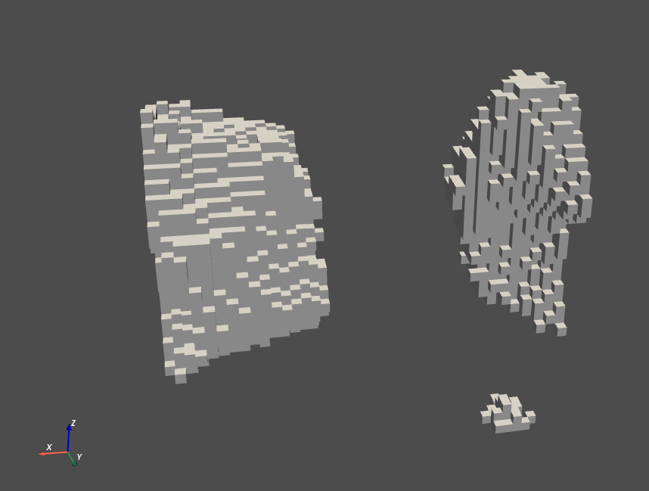
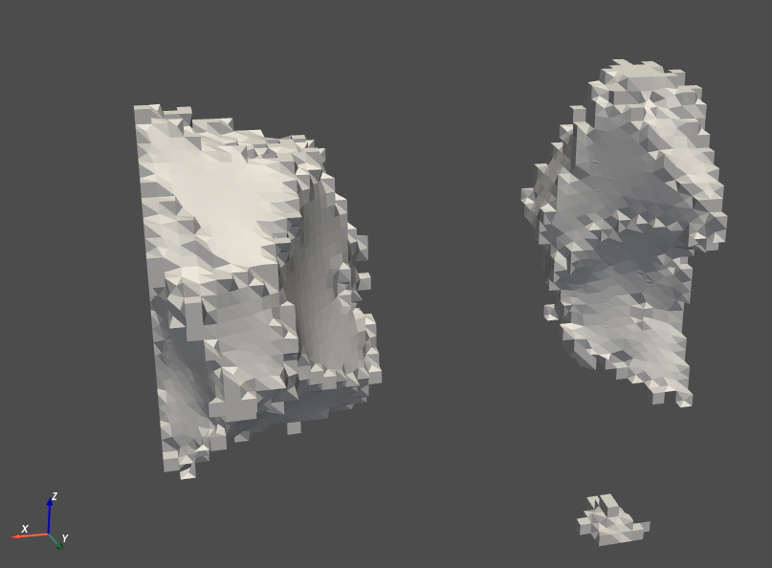
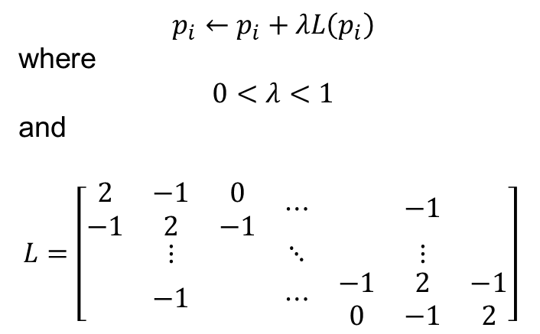
The Generation Process – Building the Model
$$p_{i}←p_{i}+λL\left(p_{i}\right)$$
where
$$0<λ<1$$
and
$$L=\left[\begin{matrix}\begin{matrix}2 & −1 & 0 \\ −1 & 2 & −1\end{matrix} & ⋯ & −1 \\ ⋮ & ⋱ & ⋮ \\ −1 & ⋯ & \begin{matrix}−1 & 2 & −1 \\ 0 & −1 & 2\end{matrix}\end{matrix}\right]$$
Source: http://graphics.stanford.edu/courses/cs468-12-spring/LectureSlides/06_smoothing.pdf

Slide 18
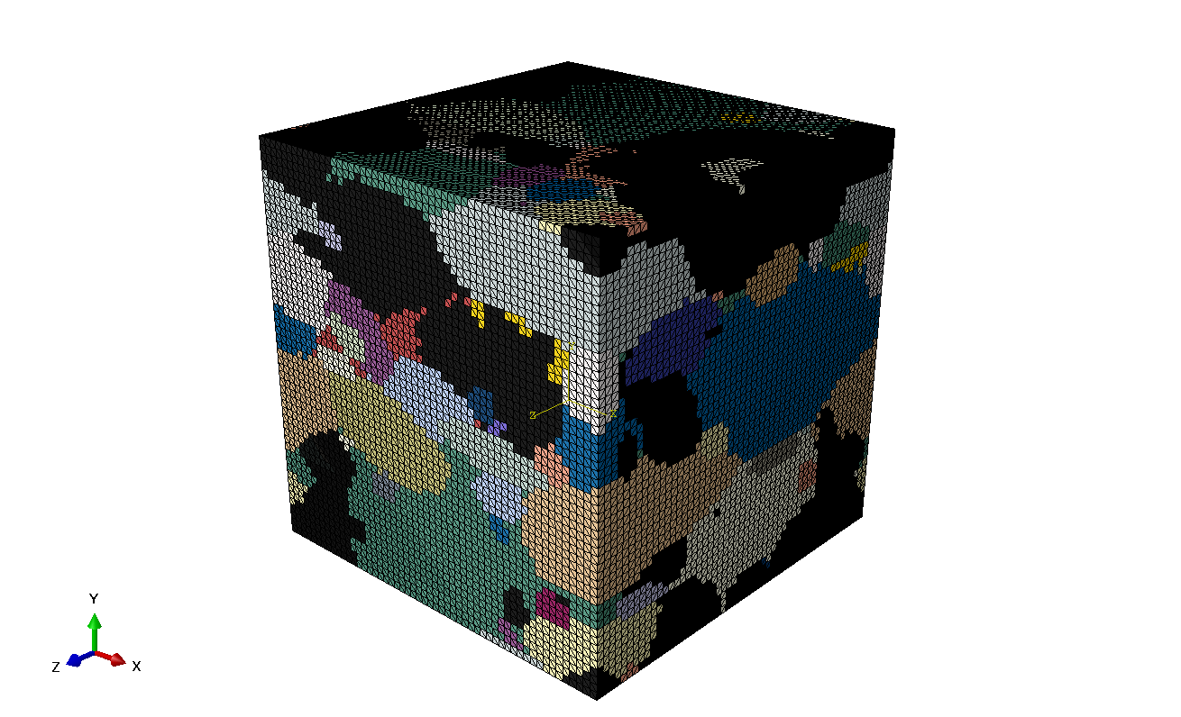
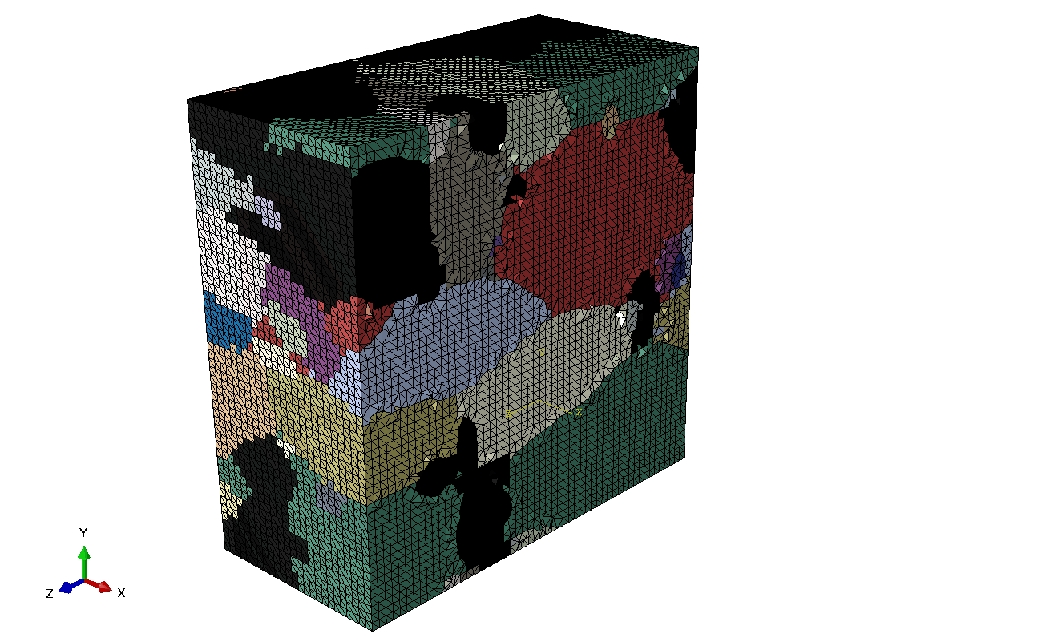
The Generation Process – Building the Model

Slide 19
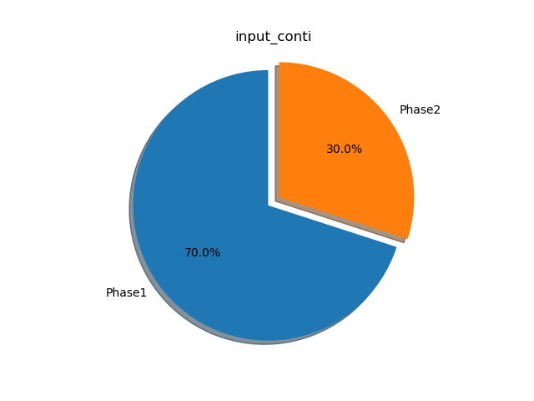
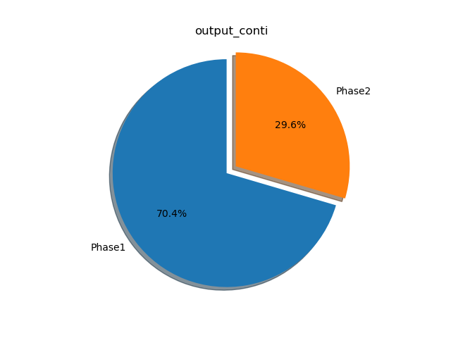
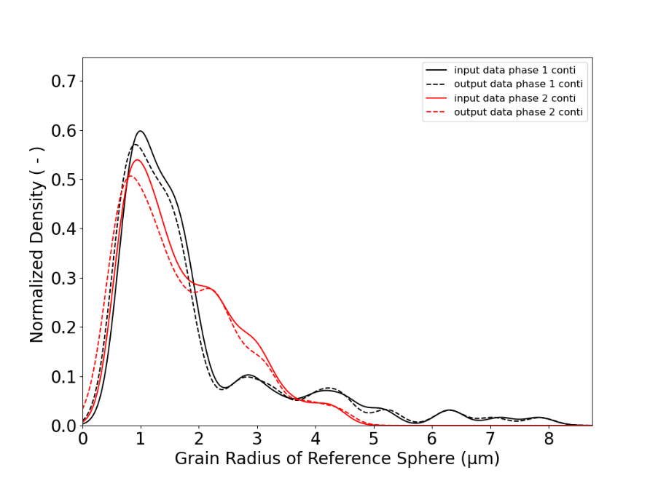


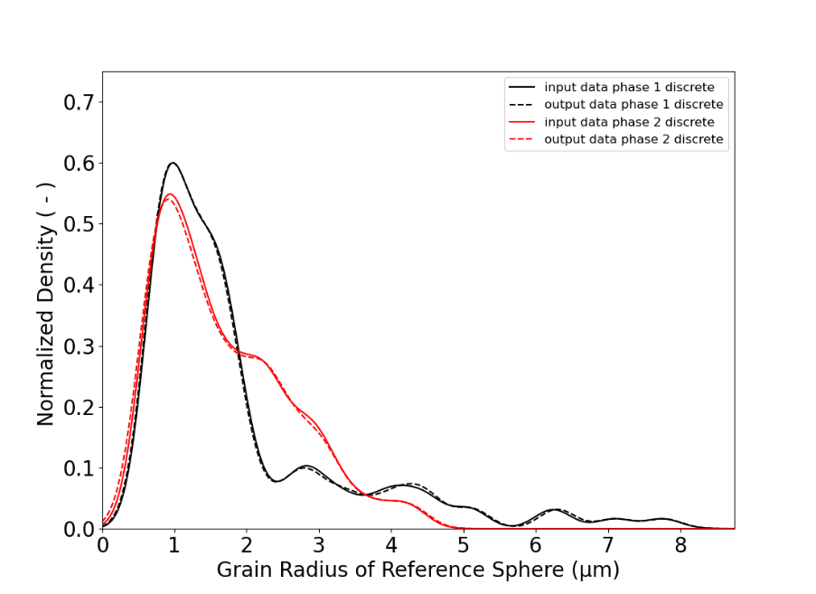
RVE-Development

Slide 20
DRAGen – The Main Idea
Microstructure analysis
LOM
SEM
Statistical analysis
Grain size
Aspect ratio
Slope
Grain packing & volume filling
Packing-Algorithm e.g. RSA
Tessellation e.g. Voronoi
Building the FE model
Generating geometries
Meshing geometries

Slide 21
What‘s next?
CWGAN-GP for full statistically valid input generation
Export filter for DAMASK_spectral
New algorithm for band generation
Inclusions and substructures
Full support for 2D-RVE
Surface smoothing
For ideas, tips and suggestions please contact: DRAGen@iehk.rwth-aachen.de

Slide 22
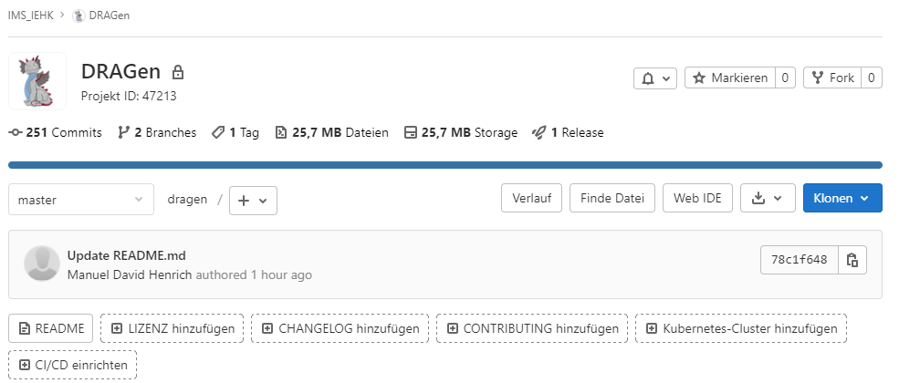
Access to DRAGen
Check out our Git Repository here

Slide 23


